Slide 1


Scholarships
Saratoga springs high school
Class of 2026

Slide 2

What is a scholarship?
A scholarship is money given to a student to help pay for further education.
Merit-based
Local
National

Slide 3

Where can I find scholarships?

Slide 4
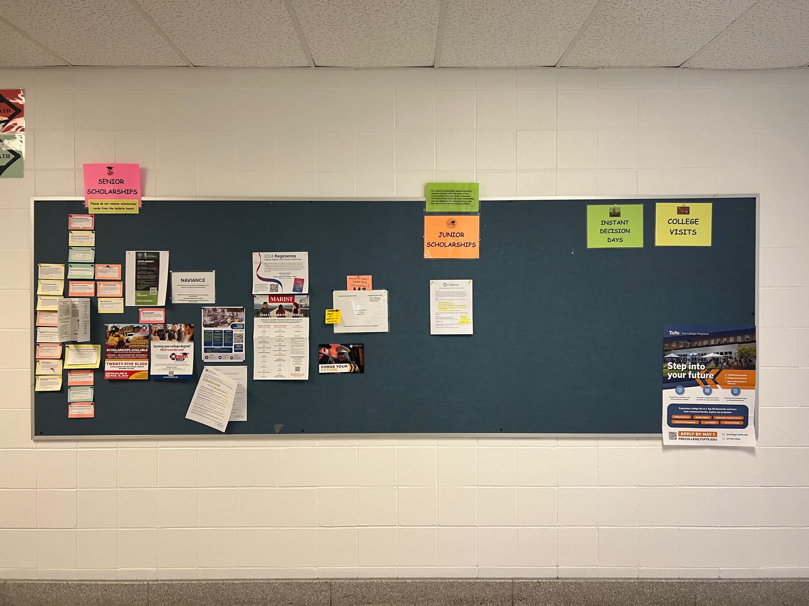

COUNSELING HALLWAY BULLETIN BOARD

Slide 5
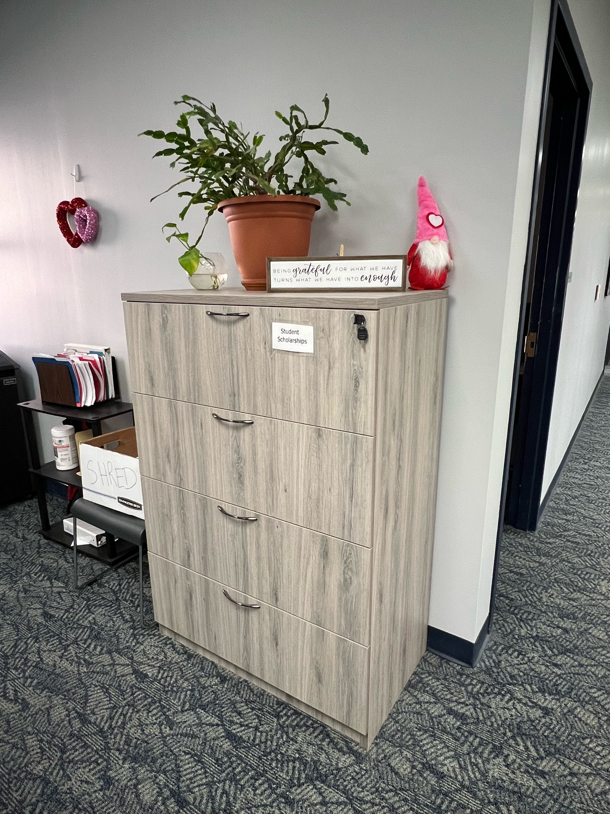
COUNSELING office filing cabinet

Slide 6
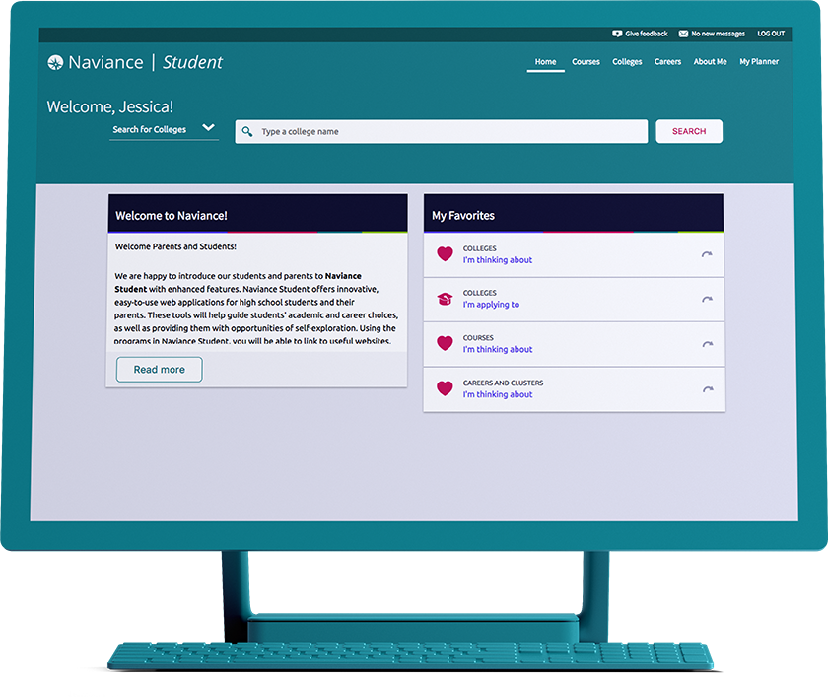
Naviance
Access through clever

Slide 7
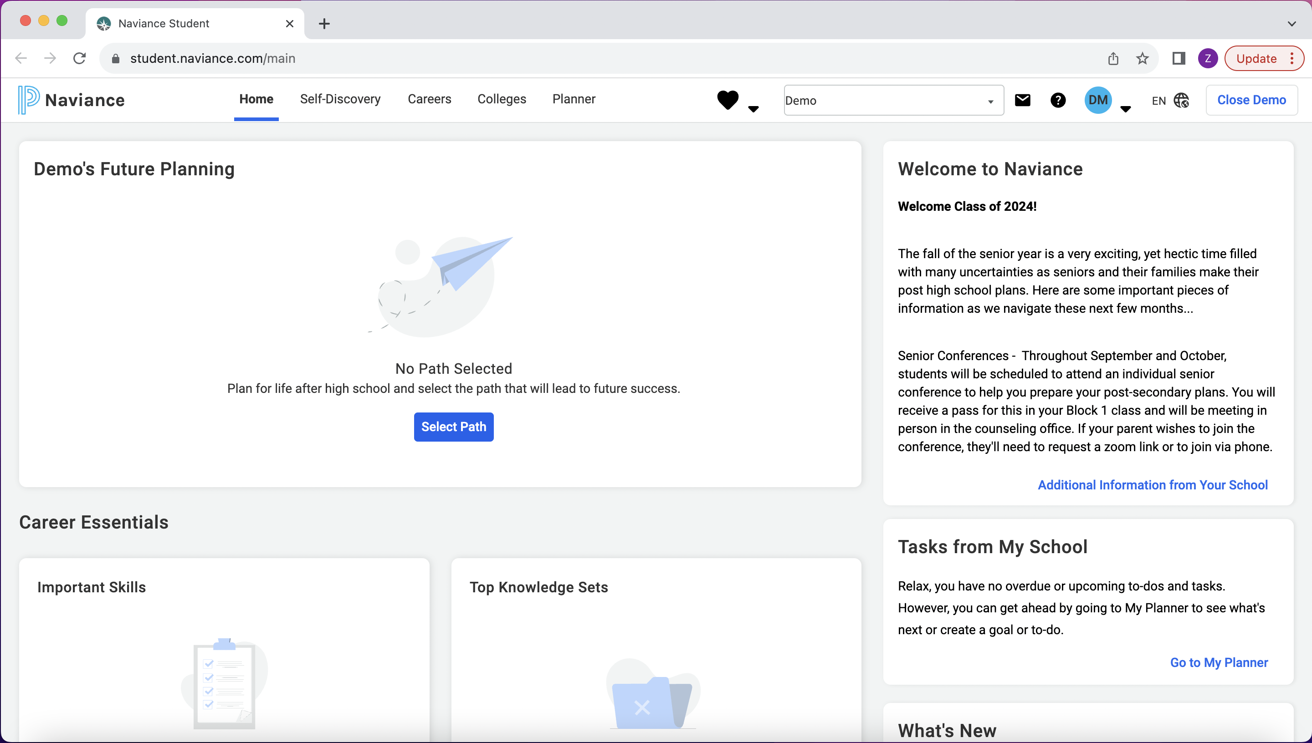

Slide 8
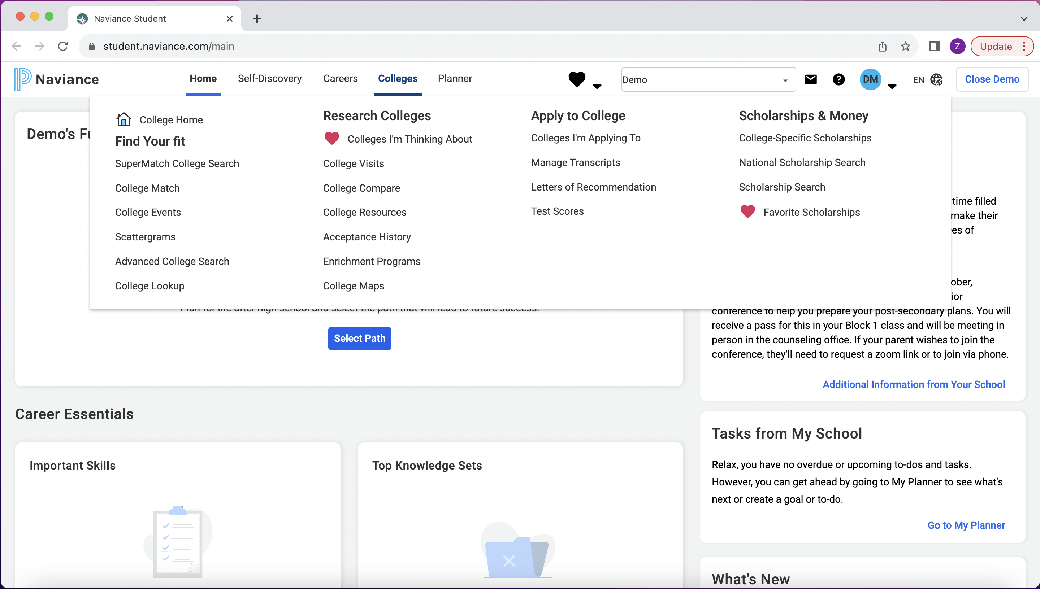

Slide 9
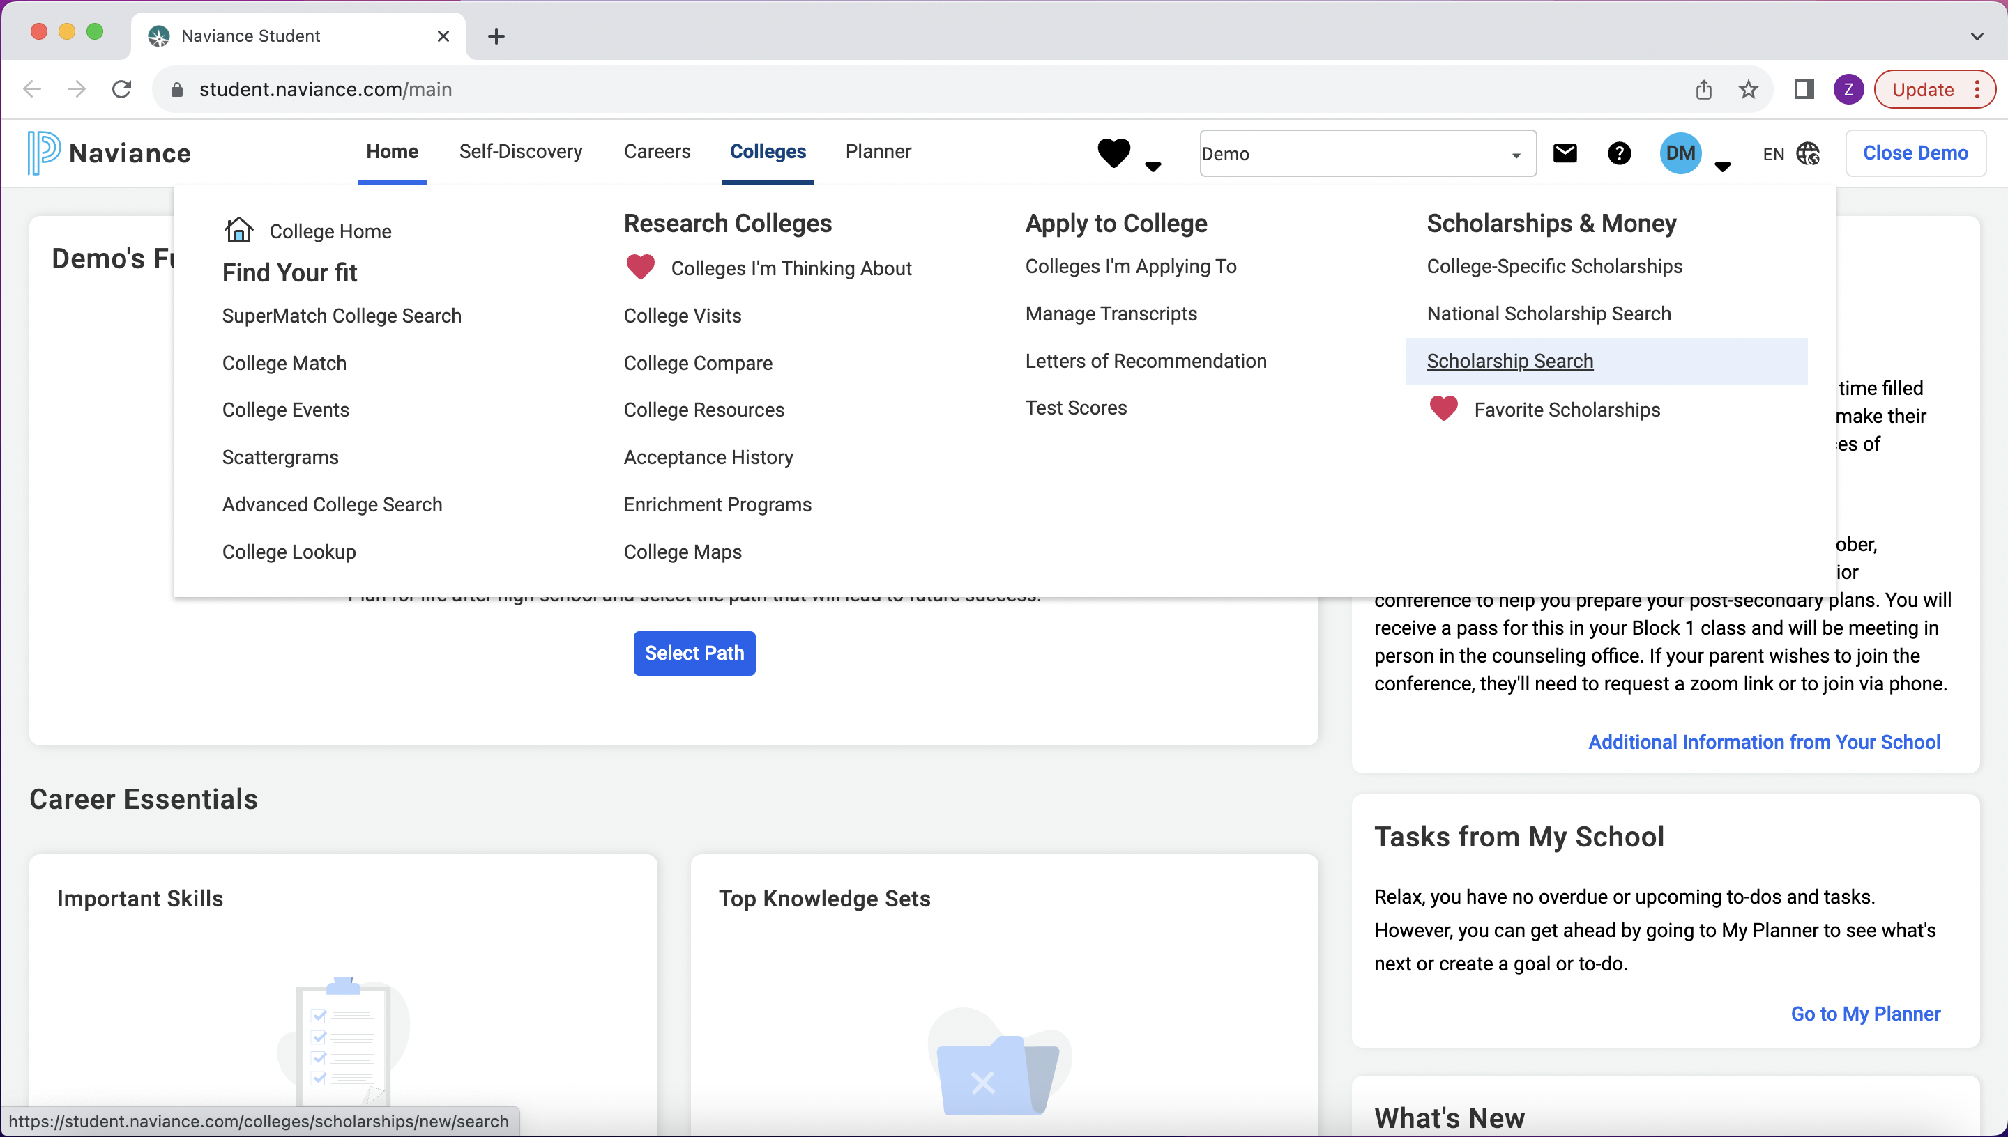

Slide 10
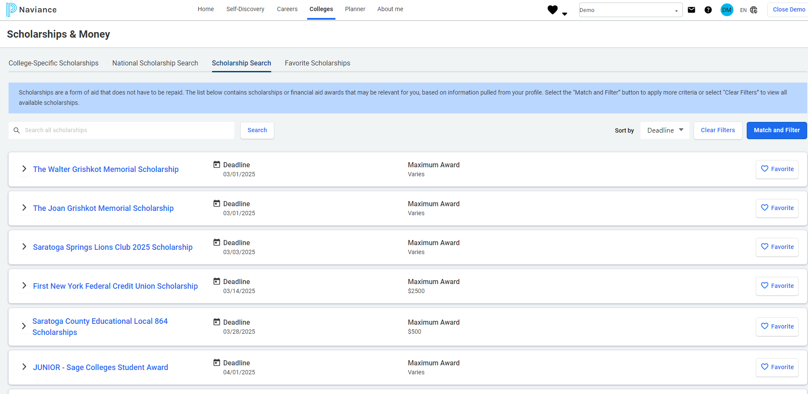

Slide 11
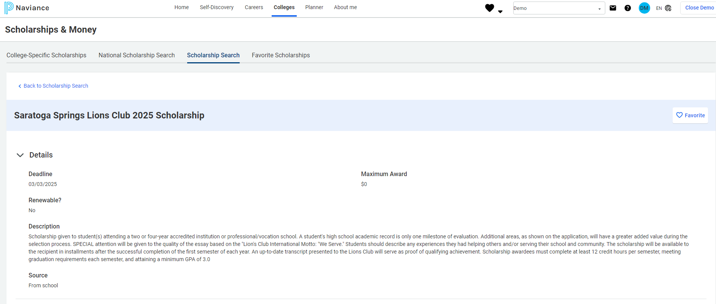

Slide 12
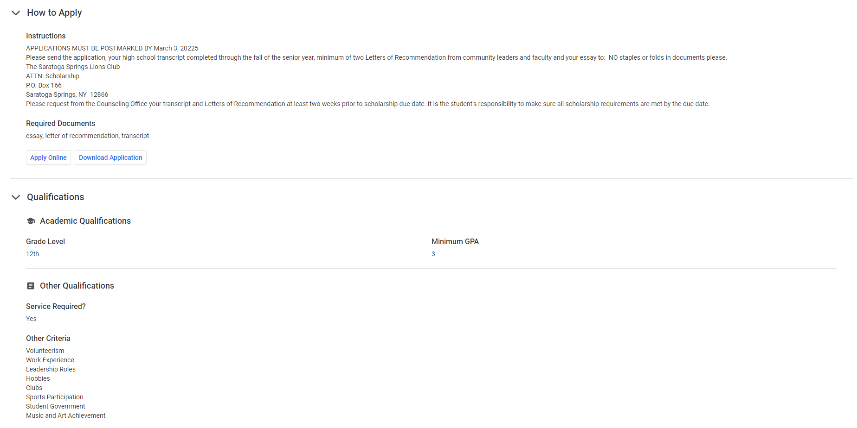

Slide 14
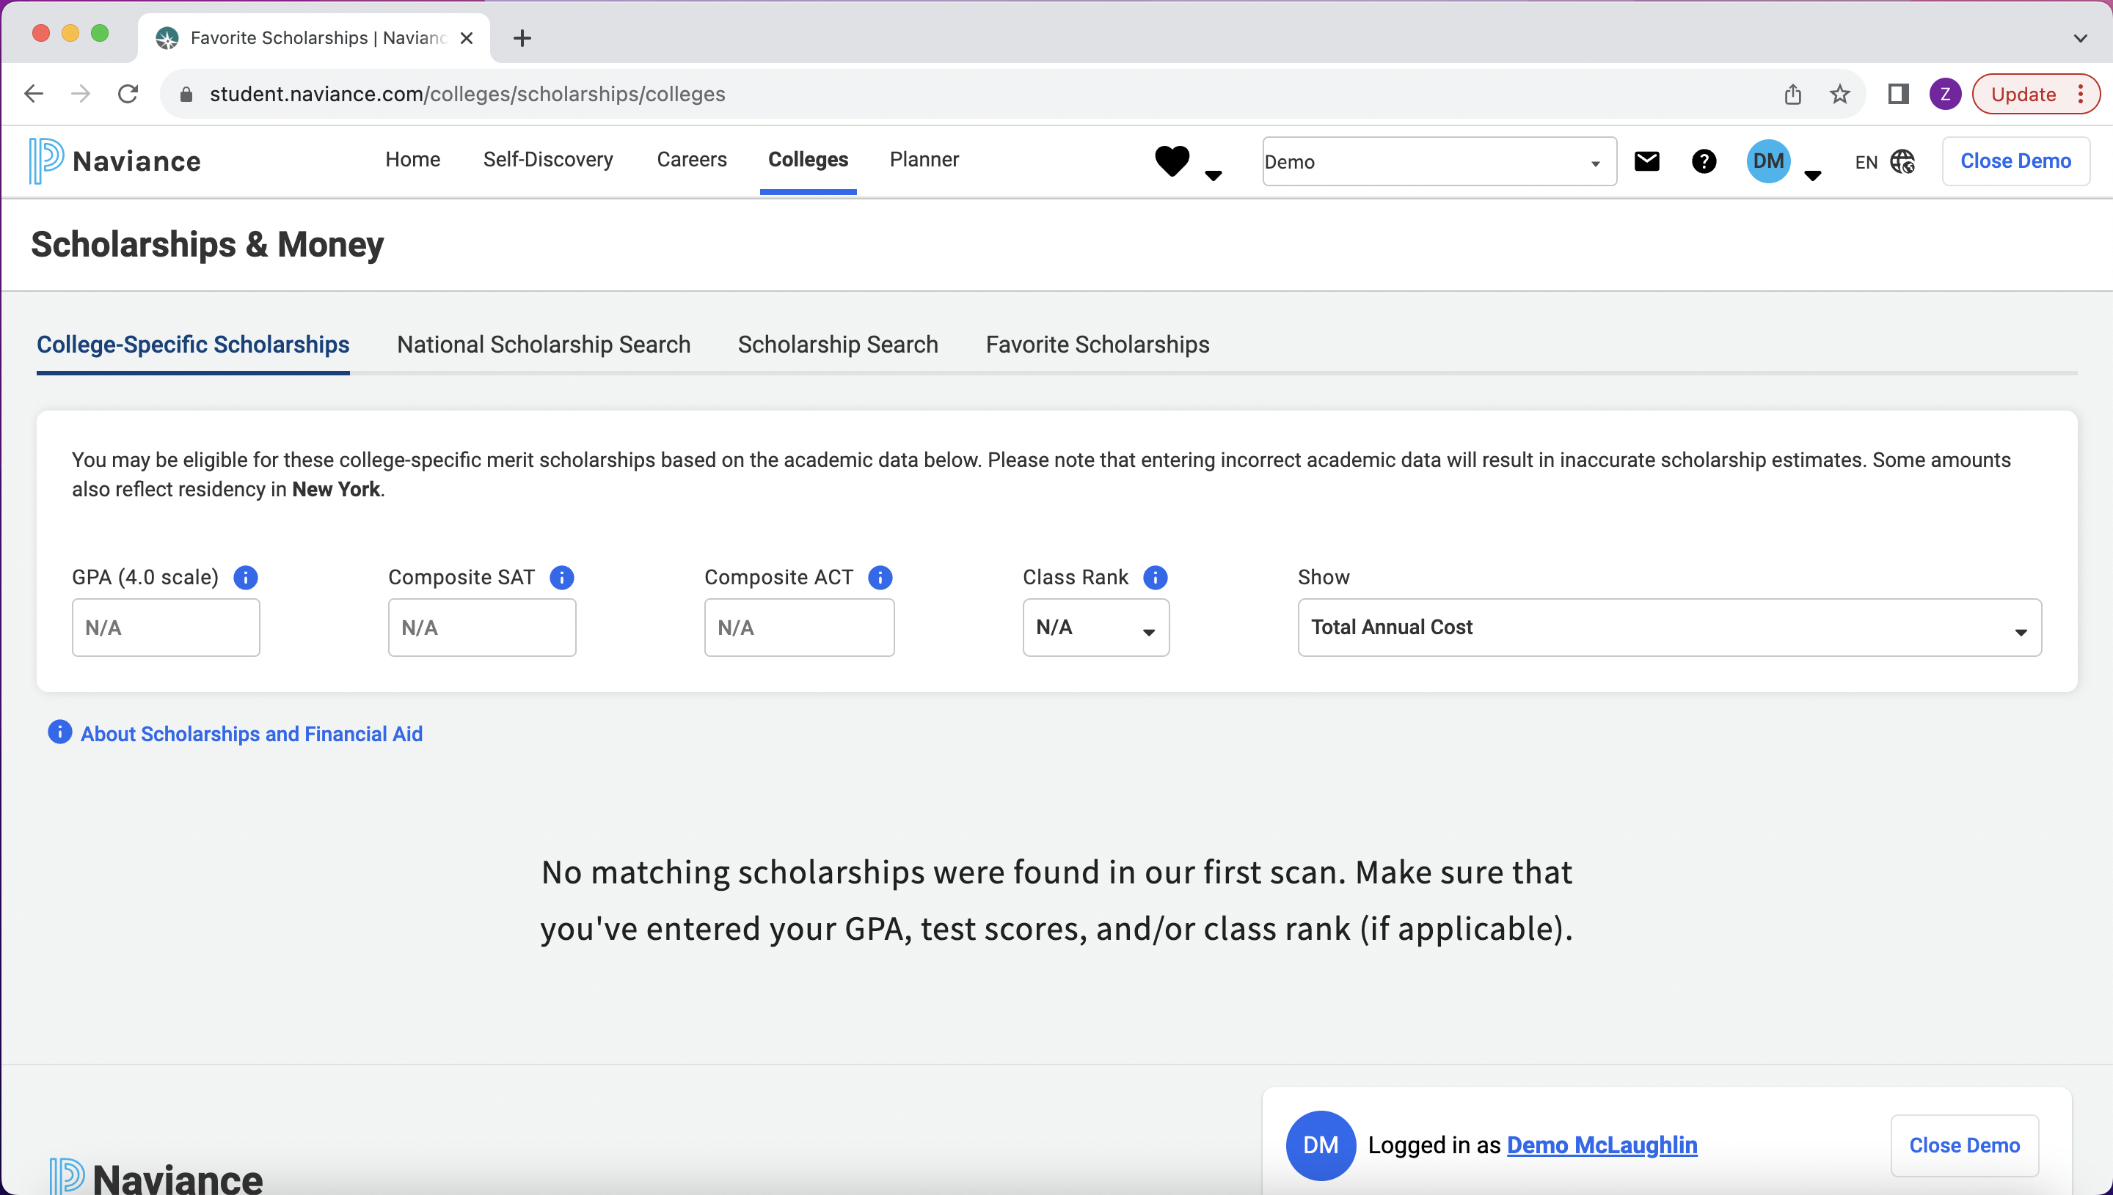

Slide 15
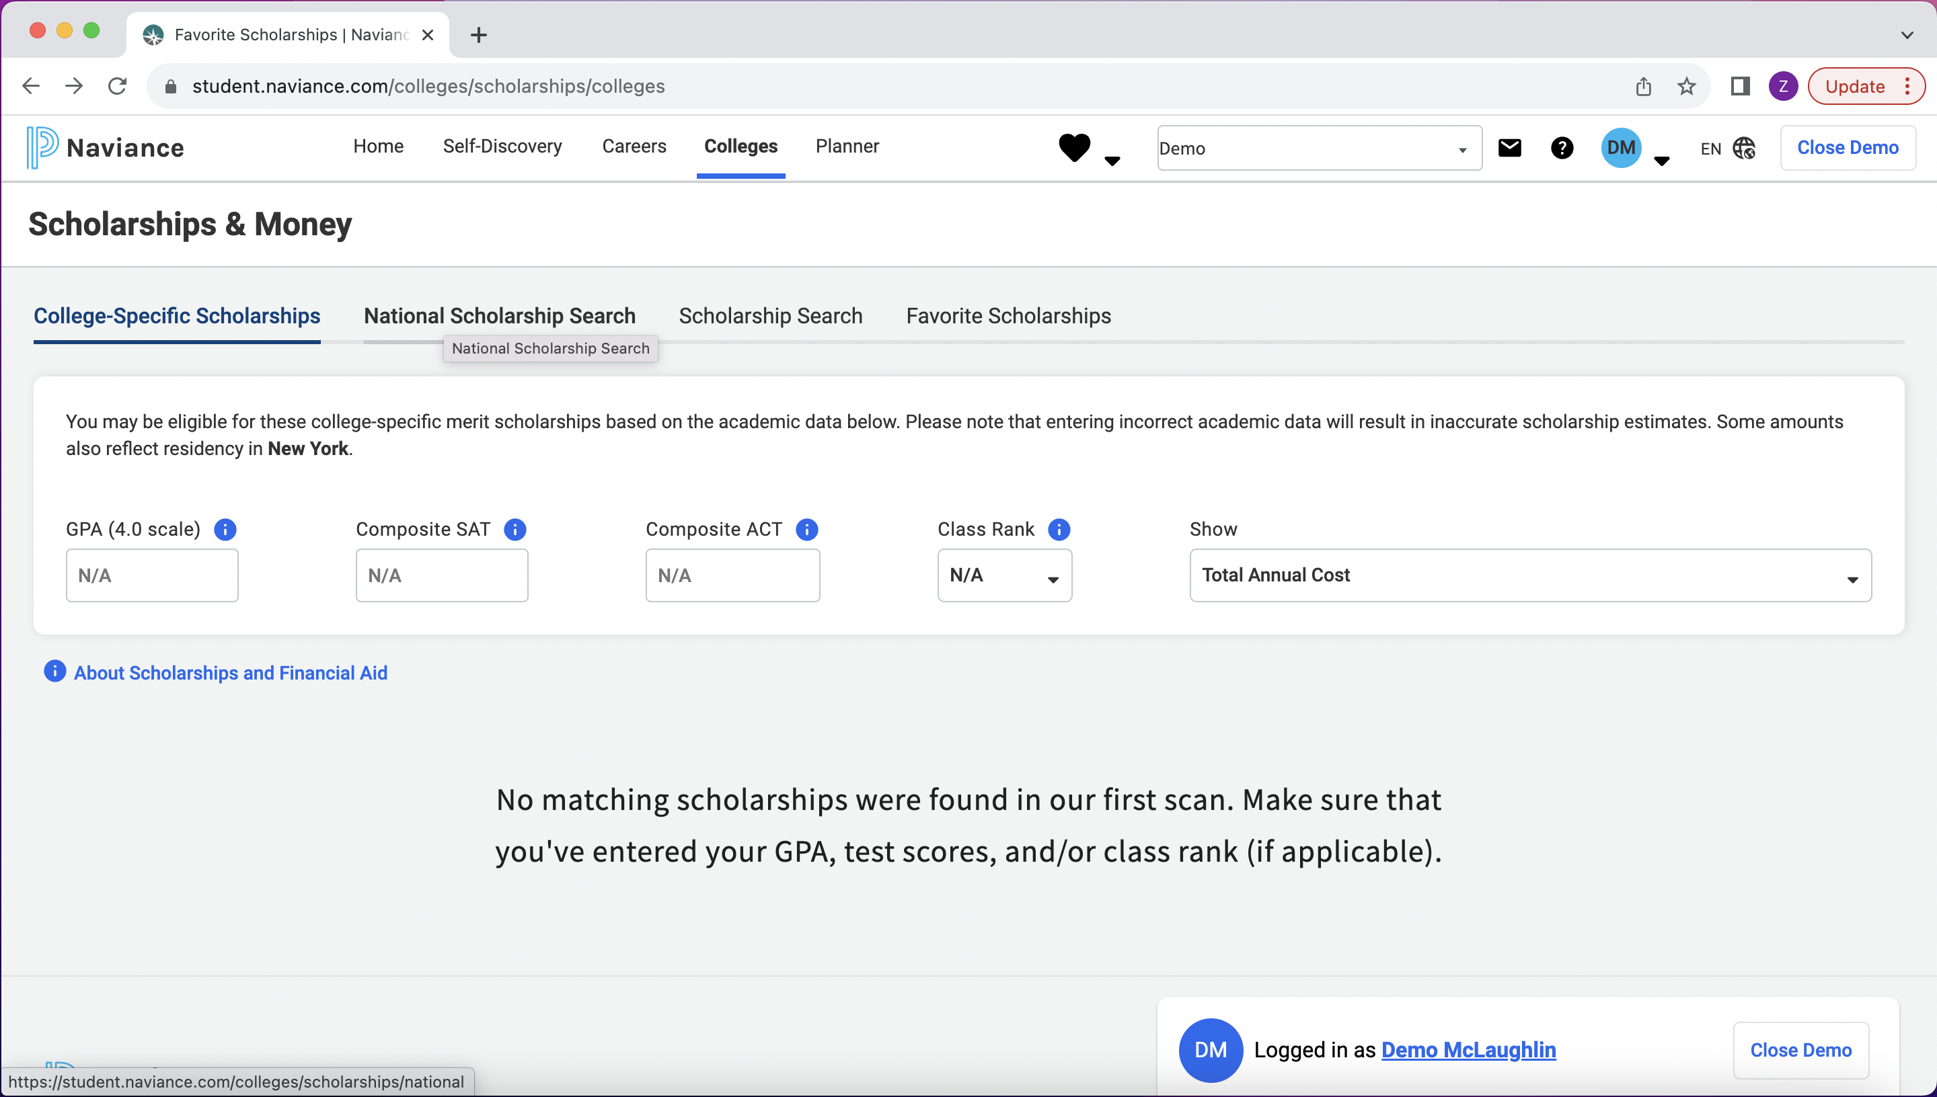

Slide 16
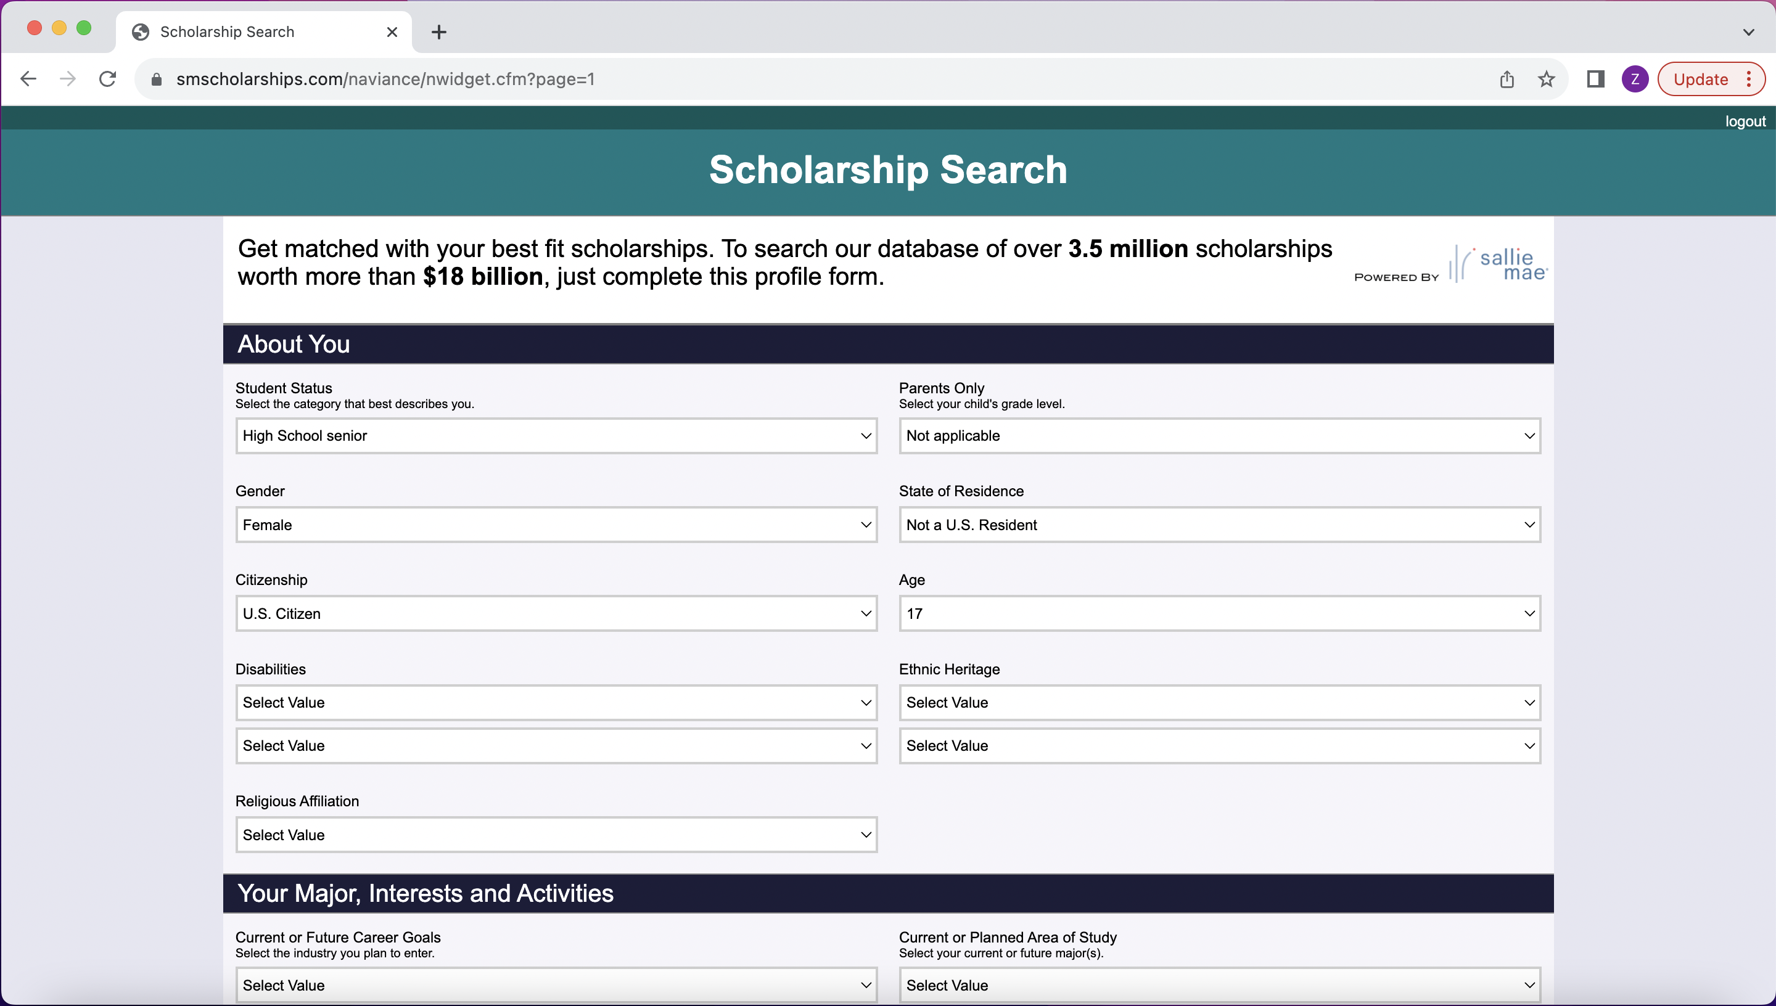

Slide 17
Processing Form for Scholarships
Before applying, please make sure you do the following:
Make sure you follow the directions of the scholarship. Each scholarship can have a different way to apply (mail or online).
Make sure the application is complete.
Make sure your essay is complete – if required
Make sure your resumé is complete – if required
You are responsible for making sure the application is completed and received by the deadline!
If your application needs materials from the Counseling office (transcript, letter(s) of recommendation, etc.), please note:
Student must come to the Counseling office to fill out a Scholarship Processing Request Form for each scholarship that needs a letter of recommendation or transcript
Reach out to Counseling office early so that there is plenty of time for processing
If you need a Letter(s) of Recommendation (LOR) – be sure to reach out to the teacher(s) or counselor(s) at least 2 weeks in advance to give them time to create one for you. The Counseling office can send your LORs for you. You just need to let the counseling office know where.
If the application needs to be mailed, you must put the materials in a manila envelope with proper postage and addressed to where it needs to go. If LORs are required, the Counseling office will mail the application for you after the LORs are added. If LORs aren't required, the student should take care of the scholarship themselves and that includes mailing it

Slide 18
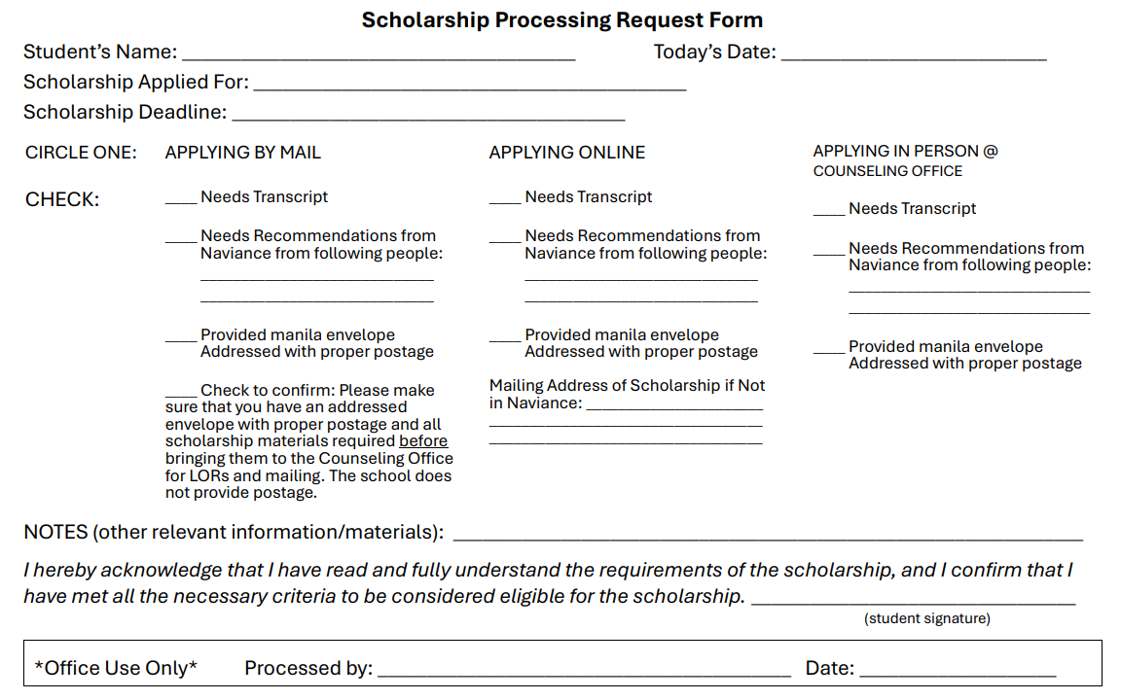
Scholarship Processing Request Form
To request processing of your scholarship through the Counseling Office, you must complete this form for each scholarship:

Slide 19
Questions?

